Slide 1

PNEUMONIA DETECTION WITH MINIMUM SUPERVISION
CMR COLLEGE OF ENGINEERING & TECHNOLOGY
Kandlakoya, Medchal, Hyderabad - 501401
Department of Computer Science and Engineering
UNDER GUIDANCE OF
Mr. Siva Skandha
Associate Professor, CSE
TEAM MEMBERS
(BATCH_51)
T.Prudhvi Reddy (19H55A0521)
V.Raju (19H55A0522)
R.Venkatesh (19H55A0523)

Slide 2
Outline
Abstract
Introduction
Literature survey
Proposed work
System architecture
Results/Output
Conclusion

Slide 3
Abstract
Pneumonia is a life-threatening infectious disease affecting one or both lungs in humans commonly caused by bacteria called Streptococcus pneumoniae. One in three deaths in India is caused due to pneumonia as reported by World Health Organization.
In case of our project, we take X-rays of chest as input and we are going to predict the disease whether it is present or not and if it’s present how much is the severity of the disease. Normally the dataset used in building the model is Chest X-Ray Dataset which is a labelled dataset but this dataset has already been used by many models which are out there and this data set is huge.
So we wanted to train our model by using Chest X-Ray dataset without labelled. we are going to train this pre-trained model with medical image datasets without label .
The learning method which we use to build this model is Self-Supervised learning by using SIMCLR scheme to detect the X-ray images and make the model learn about the images.

Slide 4
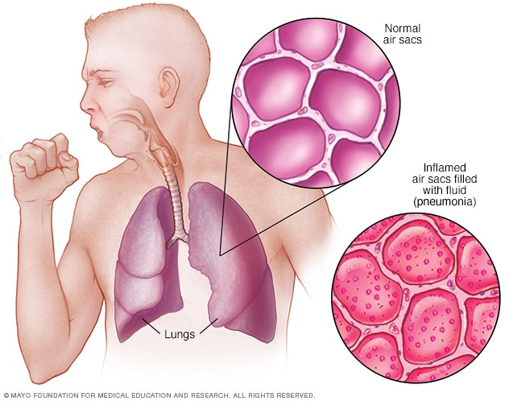
INTRODUCTION
Pneumonia is an infection that inflames the air sacs in one or both lungs. The air sacs may fill with fluid or pus.
It causes:
Cough with phlegm or pus
Fever
Chills
Muscle pain or weakness
Difficulty breathing and
Chest pain when breathing or
coughing
Bacteria, Viruses and Fungi can cause pneumonia.

Slide 5
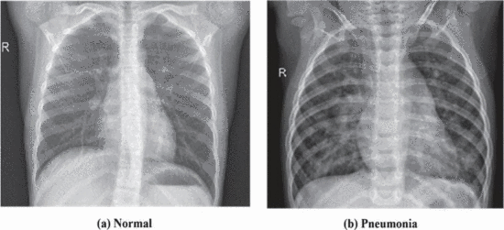
MOTIVATION OF STUDY
The main motivation behind this research was to identify Pneumonia just by using the X-Ray images of the patients.
As doctors must do a lot of certain tests to identify if the patient has Pneumonia or not
.By using this model doctors can predict the disease easy.

Slide 6
Introduction
OBJECTIVE:
To detect the pneumonia with minimum supervision by using self supervised learning by using SIMCLR framework.
By using minimum unlabeled dataset to detect pneumonia and calculate its severity.
SCOPE:
Pneumonia detection is done only with un-labeled dataset which is gray scale x-ray images.
The dataset contain 6024 images.
LI MITATIONS:
This project is only applicable to pneumonia detection and it is not applicable to other diseases.
Chest X-ray is mandatory to predict the pneumonia disease.

Slide 7
LITERATURE SURVEY
1.EXISTING SYSTEM:
Paper No | Authors | Paper title & Year of publication | Findings (Methodology, drawbacks)
1 | Amit Kumar Jaiswal, Prayag Tiwari, Sachin Kumar, Deepak Gupta d , Ashish Khanna , Joel J.P.C. Rodrigues | Identifying pneumonia in chest X-rays: A deep learning approach in CNN model ,2019 | Methodology: In this study they have a created a model based on CNN in detecting pneumonia detuction from chest X-ray images. In this model used for the multiclass classification instead of detection. The computation cost also burden exponentially when dealing with large image. Drawbacks: This project is fails to detect the normal and virus x-ray images. The accuracy of the normal and virus is about 50% and 60% respectively. And it didn’t produce any output like whether the input has pneumonia or not it produce the output as confusion matrix.

Slide 8
PNEUMONIA DETECTION USING CNN
IMPLEMENTATION
This model used for the multiclass classification instead of detection.
In this project they use CNN for image classification.
The first step of this project is preprocessing of dataset like reshaping data into fixed size and labeling the data. There are 3 labels in it they are normal, virus, bacteria.
After preprocessing of data the inputs are connected to several convolution-pooling layer pairs and hidden layers are using relu activation function and they used softmax because they wants output be the probability values.
Then they forms confusion matric this will be the output of this project.

Slide 9
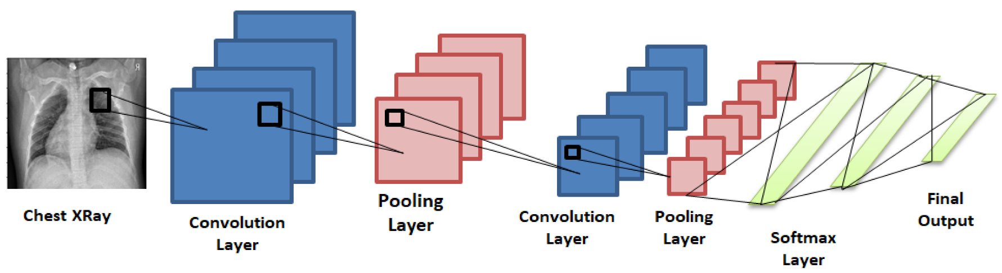
Convolutional Neural Network
After displaying the confusion matrix they check the accuracy and sensitivity of the confusion matirx.

Slide 10
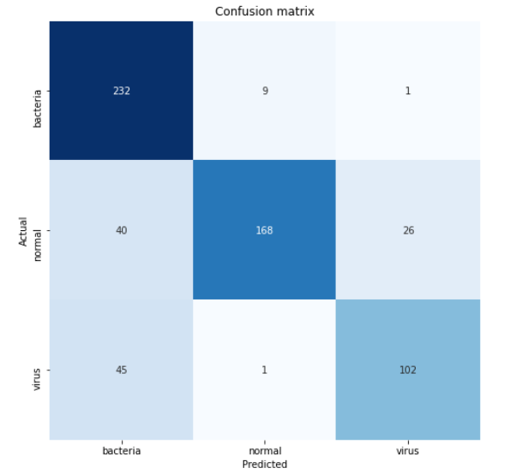
Confusion matrix constructed based on test data.
The size of the entire dataset used in this project is 1 GB.
This project is more accuracy in detecting lungs which is affected by the bacteria.
Pneumonia detection on chest X-ray Accuracy - 90%

Slide 11
Drawbacks
This project is fails to detect the normal and virus x-ray images.
The accuracy of the normal and virus is about 50% and 60% respectively.
And it didn’t produce any output like whether the input has pneumonia or not it produce the output as confusion matrix.

Slide 12
2.EXISTING SYSTEM:
Paper No | Authors | Paper title & Year of publication | Findings (Methodology, drawbacks)
2 | Amit Kumar Jaiswal, Prayag Tiwari, Sachin Kumar, Deepak Gupta d , Ashish Khanna , Joel J.P.C. Rodrigues | Identifying pneumonia in chest X-rays: A deep learning approach using Mask-RCNN model ,2019 | Methodology: In this study they have a created a model based on Mask-RCNN in detecting pneumonia symptoms from chest X-ray images. Mask-RCNN is a deep neural network developed to solve instance segmentation in particular. The computation cost also burden exponentially when dealing with large image. Drawbacks: With the usage of image augmentation, dropout and L2 regularization prevented the overfitting, but are obtained something weaker results on the training set with respect to the test.

Slide 13
IDENTIFYING PNEUMONIA IN CHEST X-RAYS USING MASK-RCNN MODEL.
IMPLEMENTATION
In this study they have a created a model based on Mask-RCNN in detecting pneumonia symptoms from chest x-ray images. Mask-RCNN is a deep neural network developed to solve instance segmentation in particular. The computation cost also burden exponentially when dealing with large image.
Mask-RCNN approach efficiently detects objects in an image while simultaneously generating a high-quality segmentation mask for each instance. The method, called mask R-CNN.
It extends faster R-CNN by adding a branch for predicting segmentation masks on each region of interest (ROI), in parallel with the existing branch for classification and bounding box regression.
The mask branch is a small FCN applied to each ROI, predicting a segmentation mask in a pixel-to pixel manner.
Mask R-CNN is simple to implement and train given the faster R-CNN framework.
In these model based on Mask-RCNN is detecting pneumonia symptoms from chest x-ray images.

Slide 14
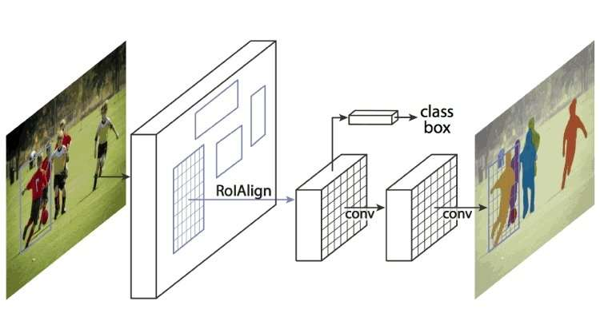
IDENTIFYING PNEUMONIA IN CHEST X-RAYS USING MASK-RCNN MODEL.

Slide 15
IDENTIFYING PNEUMONIA IN CHEST X-RAYS USING MASK-RCNN MODEL.
The size of the entire dataset used in this is 25684 images
In these model based on mask-RCNN is detecting pneumonia symptoms from chest x-ray images.
Data set link: https://public.Md.Ai/annotator/project/lxr6zdr2/workspace
Drawbacks:
With the usage of image augmentation, obtained something weaker results on the training set with respect to the test.

Slide 16
PROPOSED SYSTEM
In this system we use Chest X-Ray Dataset which is unlabeled as first step to create a pre-trained model
Using this pre-trained model we again train the model with unlabeled medical image dataset by using SIMCLR framework
SIMCLR is a framework for contrastive learning of visual representations .It learns representation by augmented views of the same data which is a way of Self-Supervised Learning.
After obtaining this model we test the model using limited medical image labeled dataset to check the accuracy of the model.

Slide 17
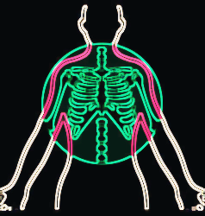

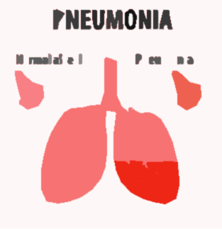
ARCHITECTURE:
Input
Supervised
Fine tuning
ADDITIONAL DOMAIN SPECIFIC TRAINING USING SIMCLR
SELF-SUPERVISED
PRE-TRAINED
MODEL
MODEL
Output

Slide 18

SIMCLR FRAMEWORK
The idea of SimCLR framework is very simple. An image is taken and random transformations are applied to it to get a pair of two augmented images xi and xj. Each image in that pair is passed through an encoder to get representations. Then a non-linear fully connected layer is applied to get representations z. The task is to maximize the similarity between these two representations zi and zj for the same image.

Slide 19
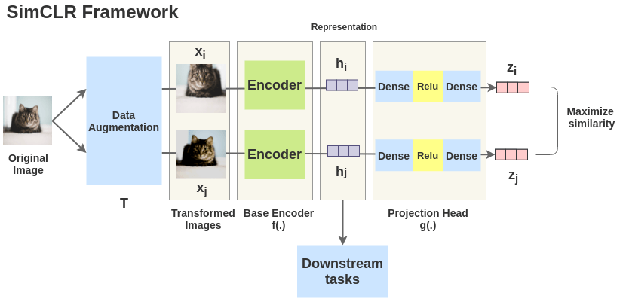
SimCLR Framework Approach
It proposes a framework called “SimCLR” for modeling the above problem in a self-supervised manner. It blends the concept of Contrastive Learning with a few novel ideas to learn visual representations without human supervision.

Slide 20
DATA COLLECTION & PERFORMANCE METRICS
A dataset from Kaggle was used. It contained 6072 Chest X-Ray Images in jpeg format and the images were categorized into a) Train b) Test and c) Validate categories. These were further broken into 2 categories, Pneumonia and Normal.
The dataset covers both Normal X-Ray images and X-Ray images with Pneumonia. As one can notice, X-Ray of a healthy human (left) would show a clear, translucent image of the lungs. Meanwhile, X-Ray of the lungs of a person suffering from Pneumonia (right) would be opacified in a focal manner as shown in figure.
Dataset Source: Kaggle website.
https://www.kaggle.com/therealcyberlord/pneumonia-detection-using-deep-learning/data

Slide 21
STEP -WISE PROCEDURE IMPLEMENTATION
Step 01 : Data Set Collection
Size of Dataset:
No of samples: 6072
No of pneumonia images: 4032
No of normal images: 2030
Dataset Source: Kaggle website
https://www.kaggle.com/therealcyberlord/pneumonia-detection-using-deep-learning/data
Step 02 : Importing Libraries and Dataset
To import libraries such as Pandas, Numpy, Opencv, Tensorflow and Matplotlib are used and Chest X-Ray Dataset is imported into model which contains normal and pneumonia Chest X-Ray images.

Slide 22
STEP -WISE PROCEDURE IMPLEMENTATION
Step 03 : Preprocessing of Data
What are the data that are collected from Chest X-Ray dataset the images are taken and perform the operations like reshaping, resizing and removing unwanted and blank images from the dataset to get a predicted output. Which helpful to get accurate results.
Step 04 : Splitting the Dataset
We took Dataset called Chest X-Ray Dataset present in Kaggle website. The chest X-Ray Dataset contains two types of images called normal Chest X-Ray images and pneumonia Chest X-Ray images by using this chest X-ray images the model can predict the pneumonia and its severity.

Slide 23
STEP -WISE PROCEDURE IMPLEMENTATION
Step 05 : Object detection and instance segmentation
Object detection is a computer technology related to computer vision and image processing that deals with detecting instances of semantic objects of a certain class (such as humans, buildings, or cars) in digital images
Instance segmentation is the task of detecting and delineating each distinct object of interest appearing in an image
Step 06 :Training the model with SimCLR
Self-supervised Formulation [Data Augmentation]
Getting Representations [Base Encoder]
Projection Head
Tuning Model: [Bringing similar closer]

Slide 24
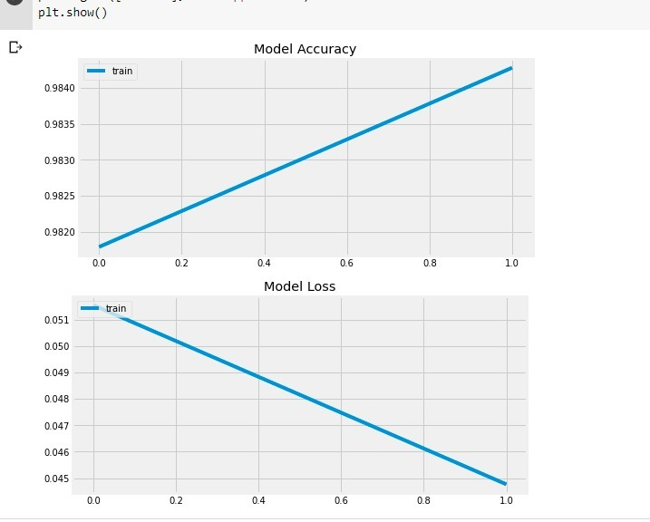
OUTPUT

Slide 25
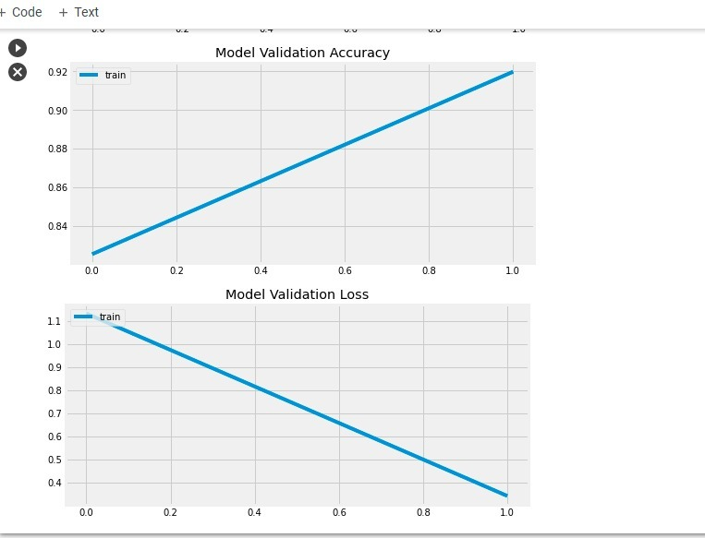
OUTPUT

Slide 26
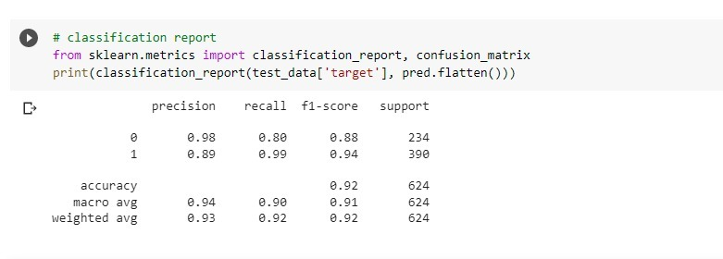
OUTPUT
Accuracy 92%

Slide 27
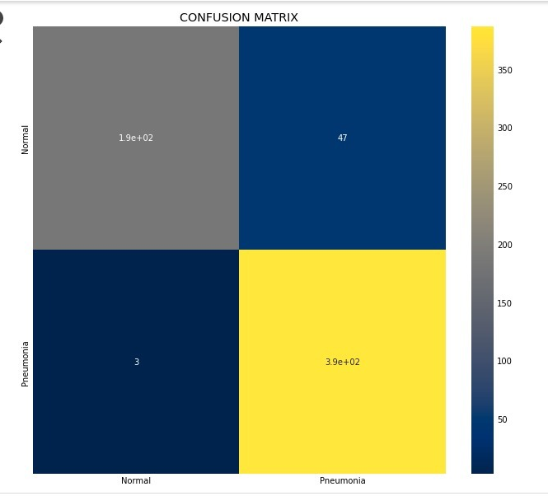
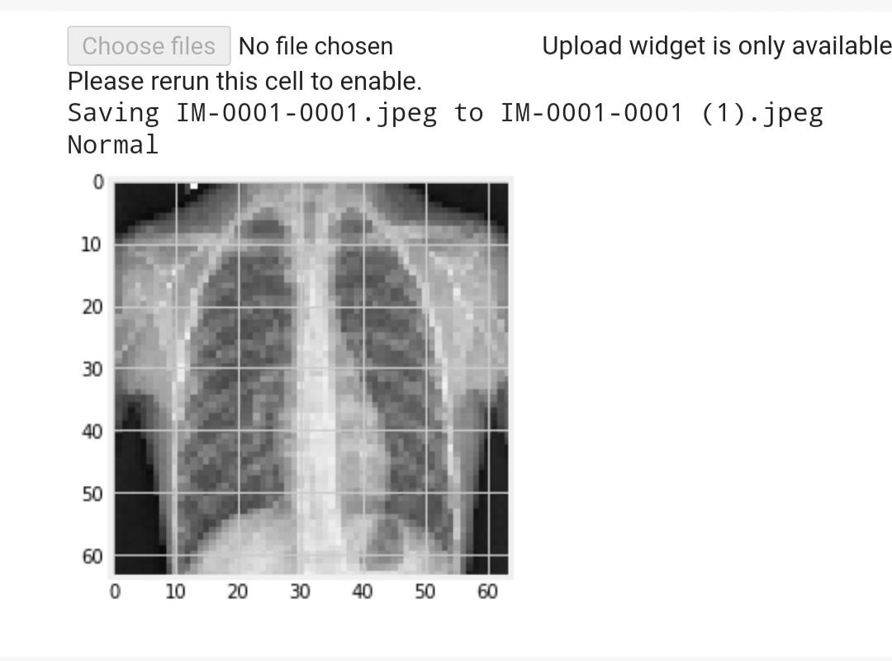
OUTPUT

Slide 28
References
https://amitness.com/2020/03/illustrated-simclr/#:~:text=The%20idea%20of%20SimCLR%20framework,applied%20to%20get%20representations%20z.
https://www.kaggle.com/therealcyberlord/pneumonia-detection-using-deep-learning/data
https://amitness.com/2020/03/illustrated-simclr/#:~:text=Downstream%20Tasks,obtained%20from%20the%20projection%20head.
https://medium.com/@nainaakash012/simclr-contrastive-learning-of-visual-representations-52ecf1ac11fa
https://arxiv.org/pdf/2002.05709.pdf

Slide 29
Thank you!!!

